Slide 1

BANK MANAGEMENT SYSTEM
Team MEMBERS :
Vaishnavi – 2021BCSE07AED296
A VEENA reddy – 2021BCSE07aed338
Manisha rathOr – 2021bcse07aed323
Aanchal singh – 2021bcse07aed325
Monica marani – 2021bcse07aed363
..

Slide 2

INTRODUCTION
About our Project
The project entitled “Bank management system” is a computerized telecommunications device that provides the customers of a financial institution with access to financial transactions in a public space without the need for a human clerk or bank taller (manpower).

Slide 3

Feature
The Main Features of a bank is that it deals with all the money-related transactions. For example, you can deposit your money in a bank account to save it securely, and you will also get interested in the money that you will save in the account.

Slide 4
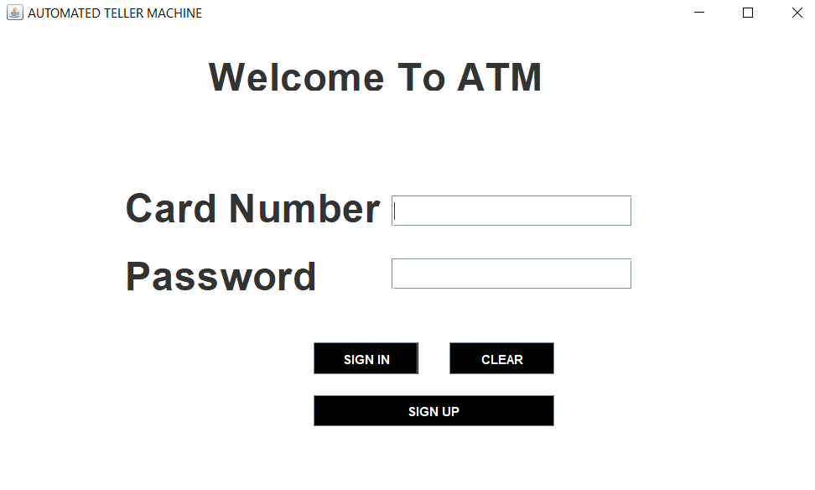
LOGIN PAGE
import java.awt.Color;
import java.awt.Font;
import java.awt.event.ActionEvent;
import java.awt.event.ActionListener;
import javax.swing.JButton;
import javax.swing.JFrame;
import javax.swing.JLabel;
import javax.swing.JPasswordField;
import javax.swing.JTextField;
import java.sql.*;
import javax.swing.JOptionPane;
Jbutton, JTextField, JPasswordField, JLabel
setSize, setTitle, setBounds, setFont, setBackground, setForeground, addActionListener

Slide 5

SIGNUP
..

Slide 6
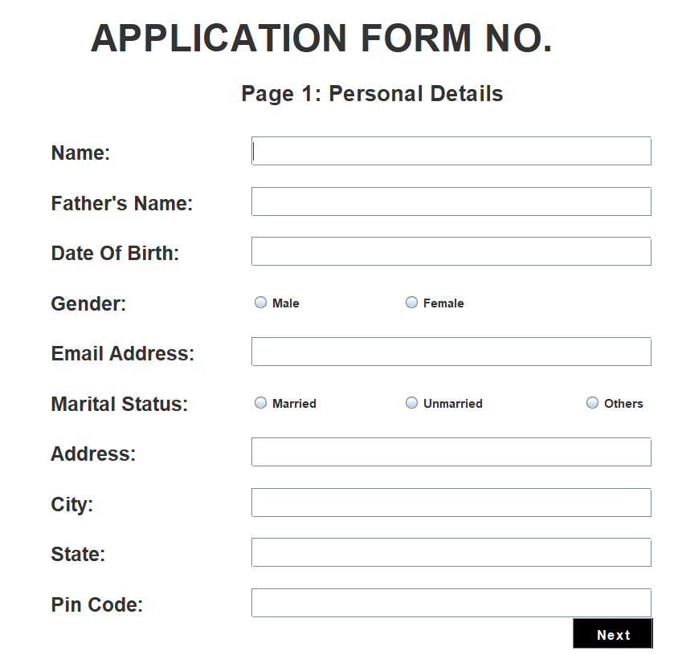
Signup PAGE 1
import javax.swing.*;
import java.awt.event.*;
import java.awt.*;
import java.util.*;
Jbutton, JTextField, JRadioButton
setSize, setTitle, setBounds, setFont, setBackground, setForeground, addActionListener

Slide 7
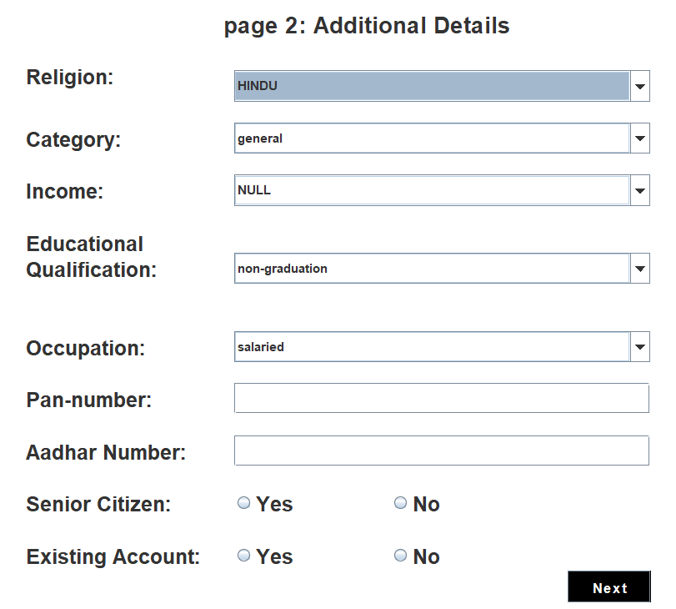
Signup PAGE 2
import javax.swing.*;
import java.awt.*;
import java.awt.event.*;
Jbutton, JTextField, JRadioButton, JComboBox
setSize, setTitle, setBounds, setFont, setBackground, setForeground, addActionListener

Slide 8
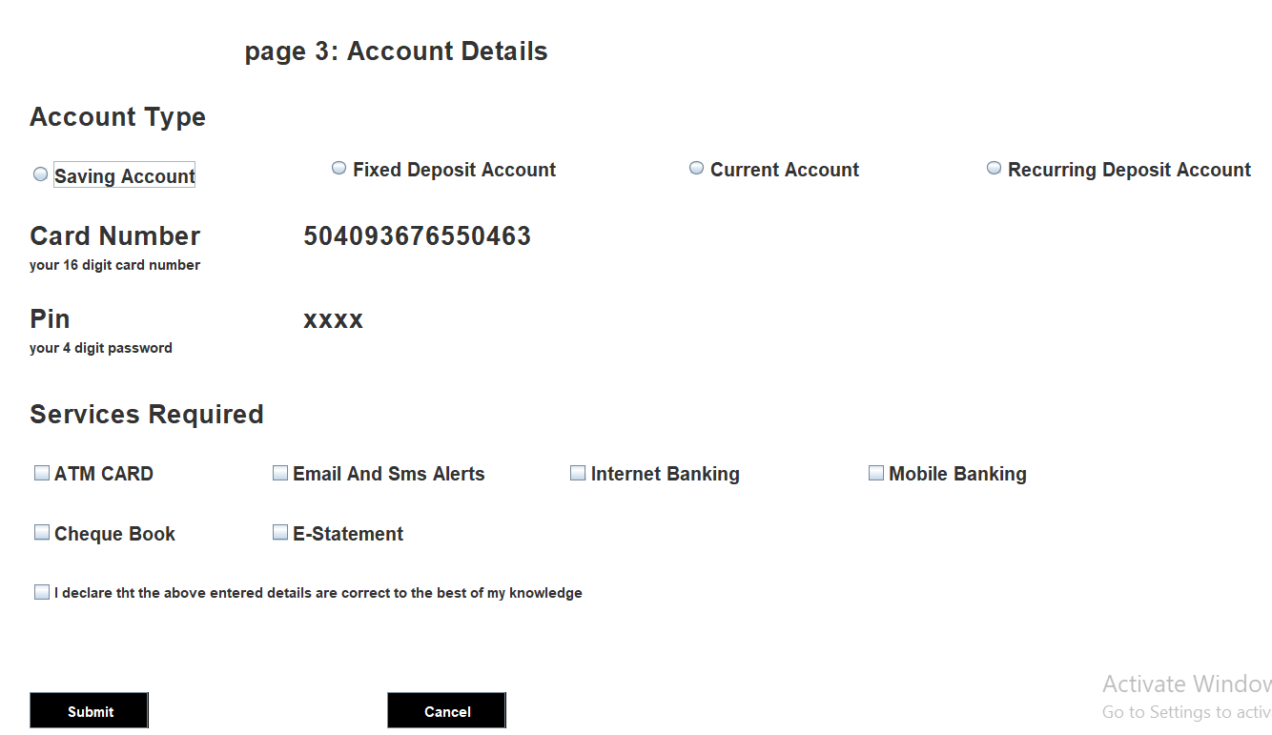
Signup PAGE 3
import javax.swing.*;
import java.awt.*;
import java.awt.event.*;
import java.util.*;
import java.sql.*;
Jbutton, JTextField, JRadioButton, JCheckBox, JOptionPane
setSize, setTitle, setBounds, setFont, setBackground, setForeground, addActionListener, showMessageDialog

Slide 9
SIGN IN
..

Slide 10
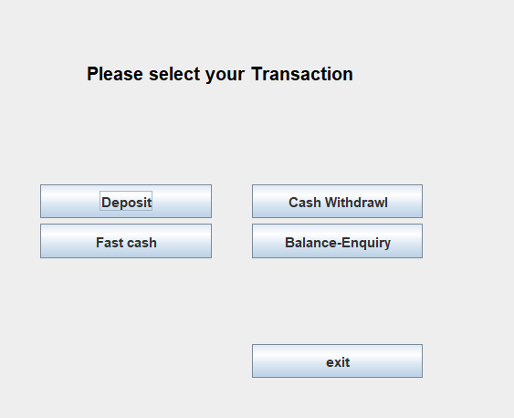
Transaction
import javax.swing.*;
import java.awt.*;
import java.awt.event.*;
Jbutton, JLabel
setSize, setTitle, setBounds, setFont, setBackground, setForeground, addActionListener

Slide 11
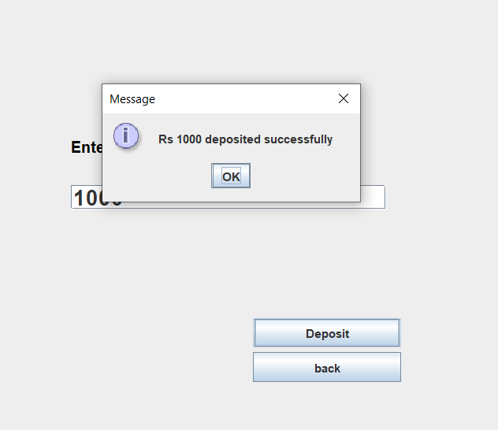
Deposit
import javax.swing.*;
import java.awt.*;
import java.awt.event.*;
import java.util.*;
Jbutton, JTextField, Jlabel, JOptionPane
setSize, setTitle, setBounds, setFont, setBackground, setForeground, addActionListener, showMessageDialog

Slide 12
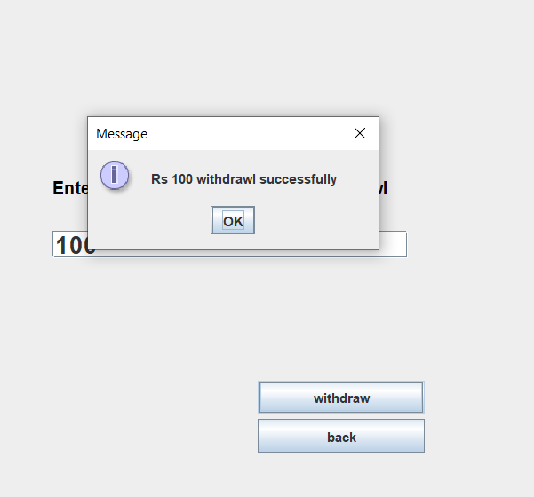
Withdrawl
import javax.swing.*;
import java.awt.*;
import java.awt.event.*;
import java.util.*;
Jbutton, JTextField, Jlabel, JOptionPane
setSize, setTitle, setBounds, setFont, setBackground, setForeground, addActionListener, showMessageDialoge

Slide 13
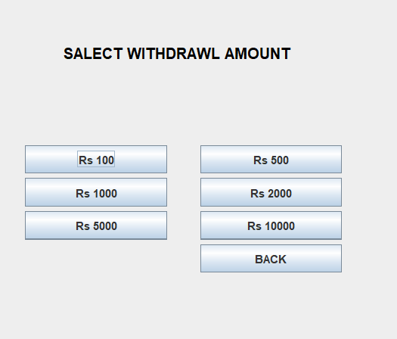
FAST Cash
import javax.swing.*;
import java.awt.*;
import java.awt.event.*;
import java.util.*;
Jbutton, Jlabel, JOptionPane
setSize, setTitle, setBounds, setFont, setBackground, setForeground, addActionListener, showMessageDialog

Slide 14
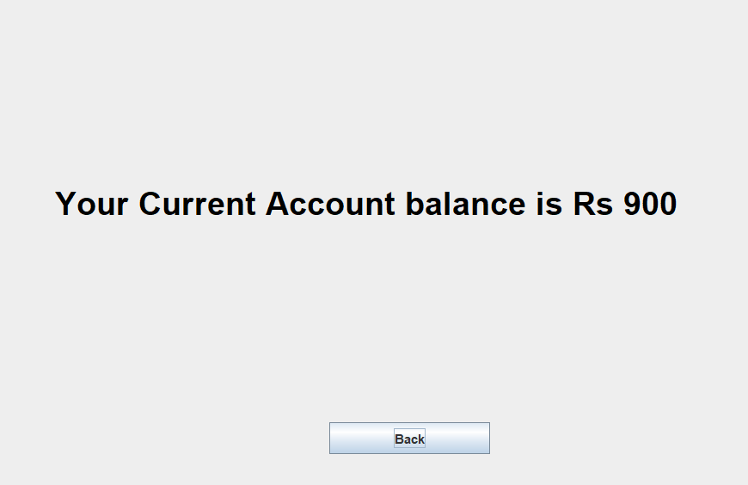
Bank Balance
import javax.swing.*;
import java.awt.*;
import java.awt.event.*;
import java.sql.*;
Jbutton, JLabel
setSize, setTitle, setBounds, setFont, setBackground, setForeground, addActionListener

Slide 15
DATABASE
..

Slide 16
DATABASE CONNECTION
..
ODBC (Open Database Connectivity) Driver
JDBC (Java Database Connection) Driver
Groups of classes - packages

Slide 17
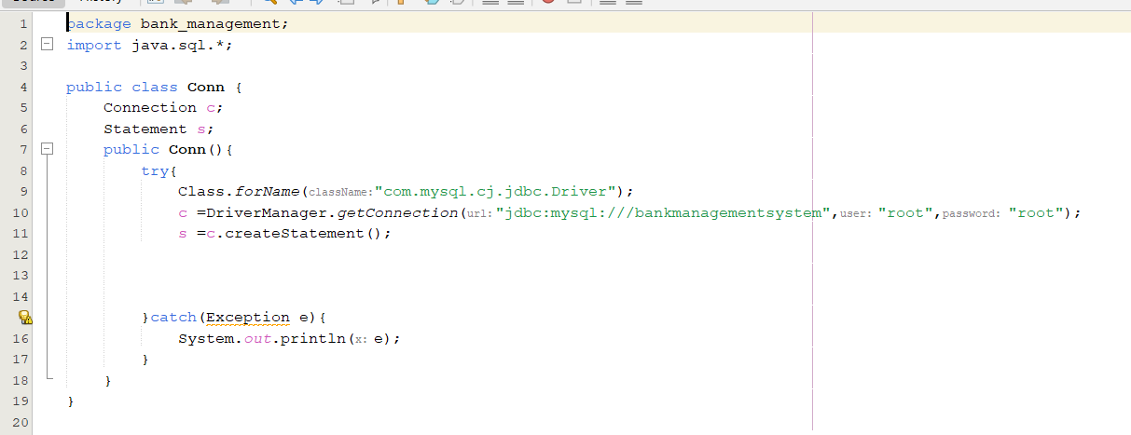
HOW?
JDK -20

Slide 18
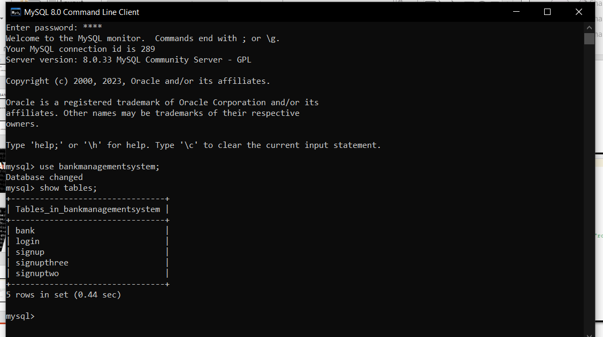
IN MYSQL

Slide 19
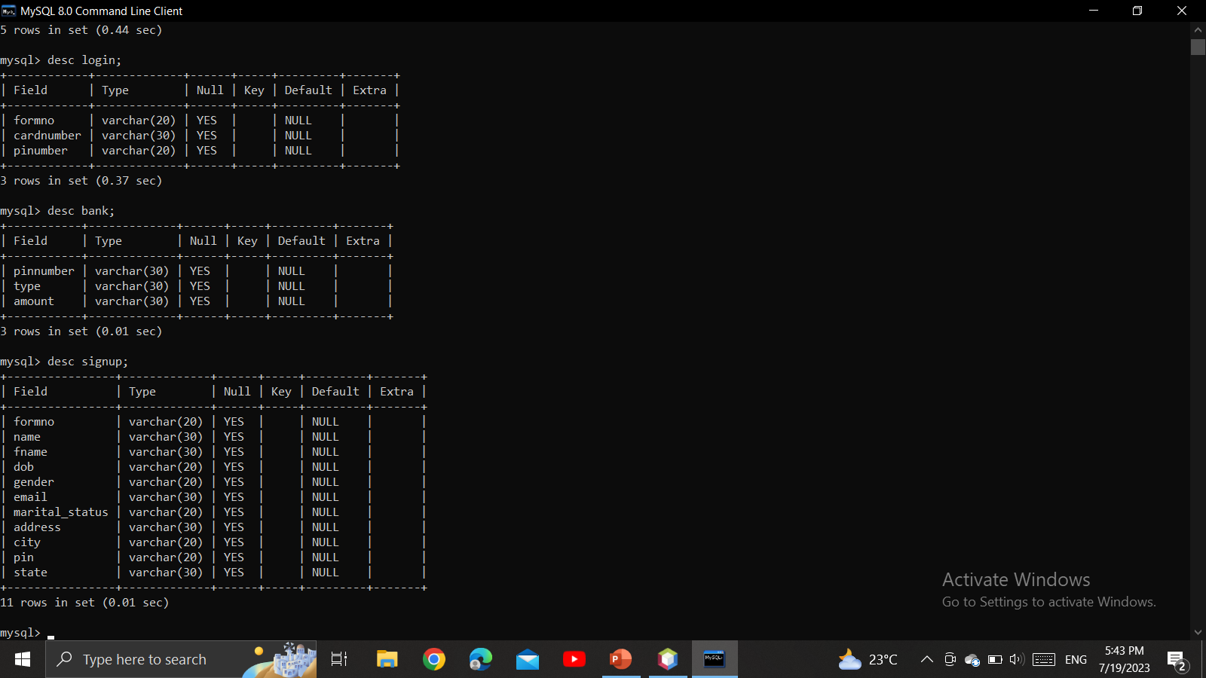
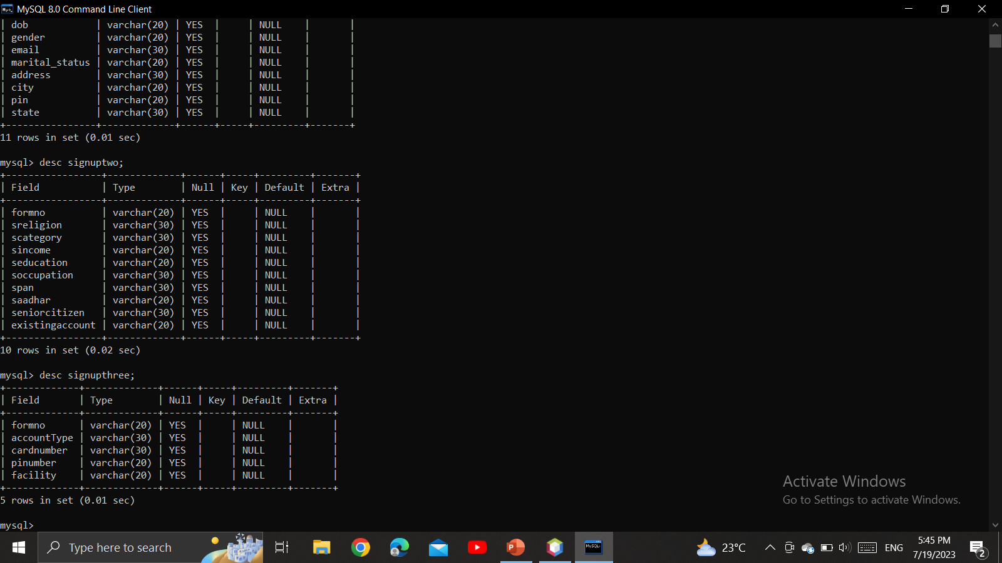
Description Of tables

Slide 20
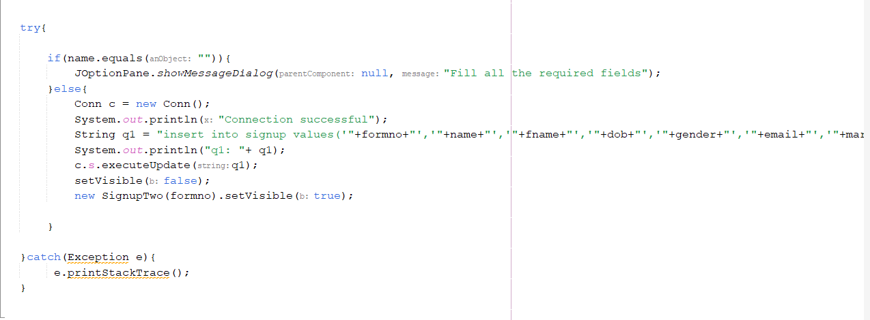
HOW?

Slide 21
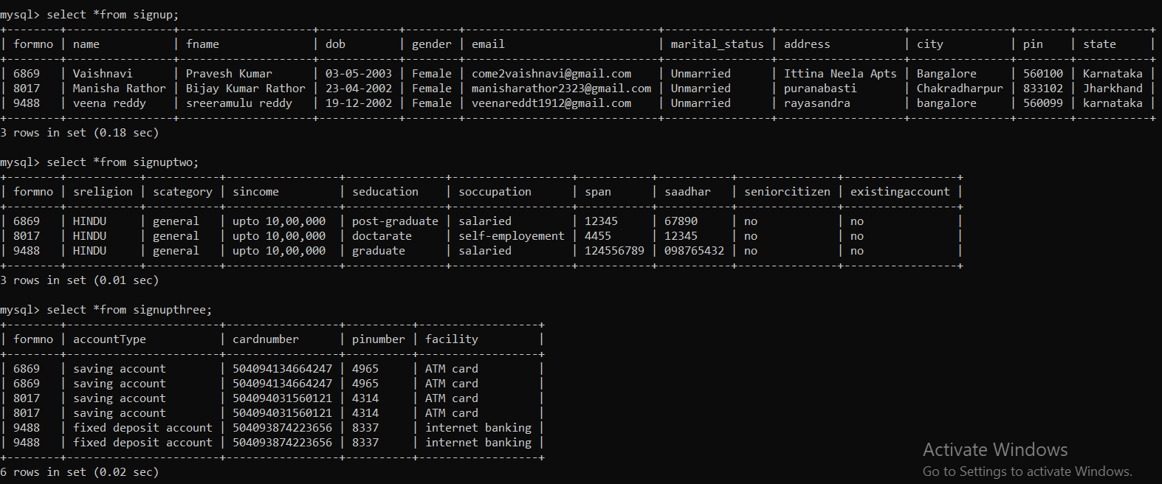
Data in the tables

Slide 22
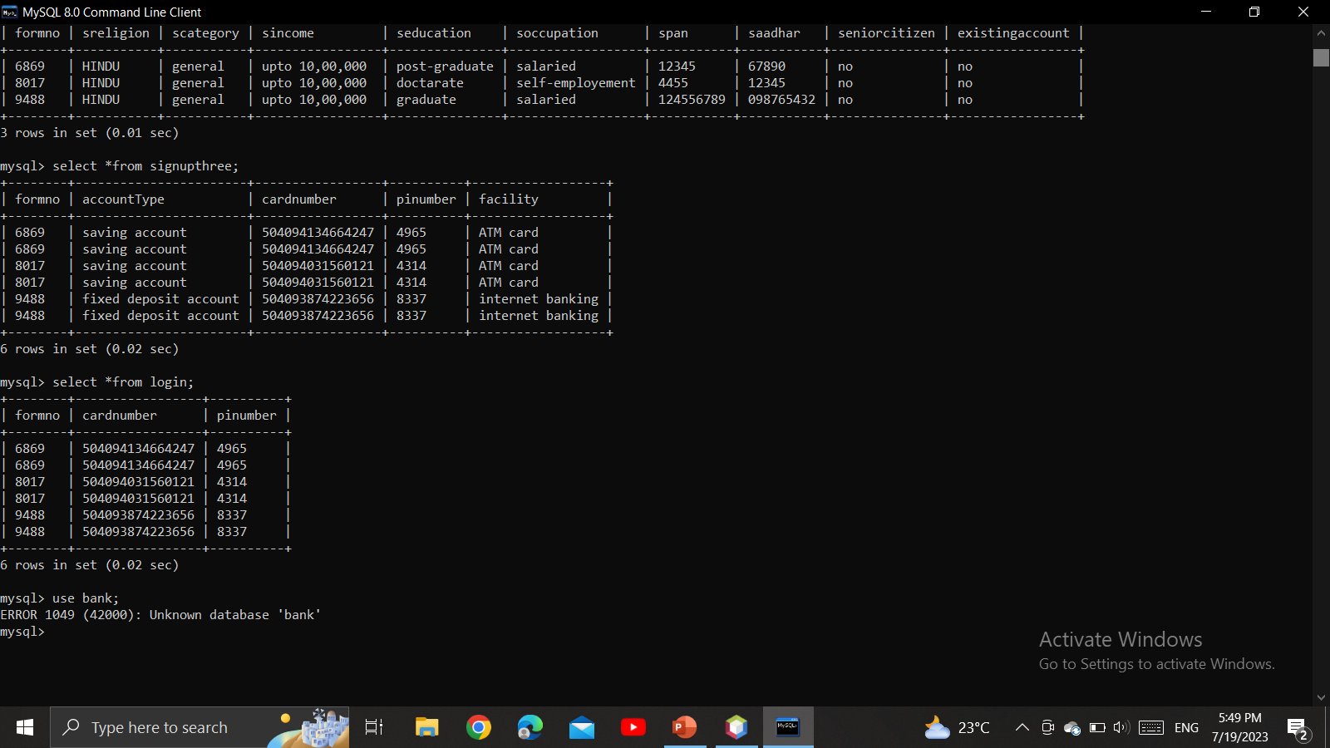
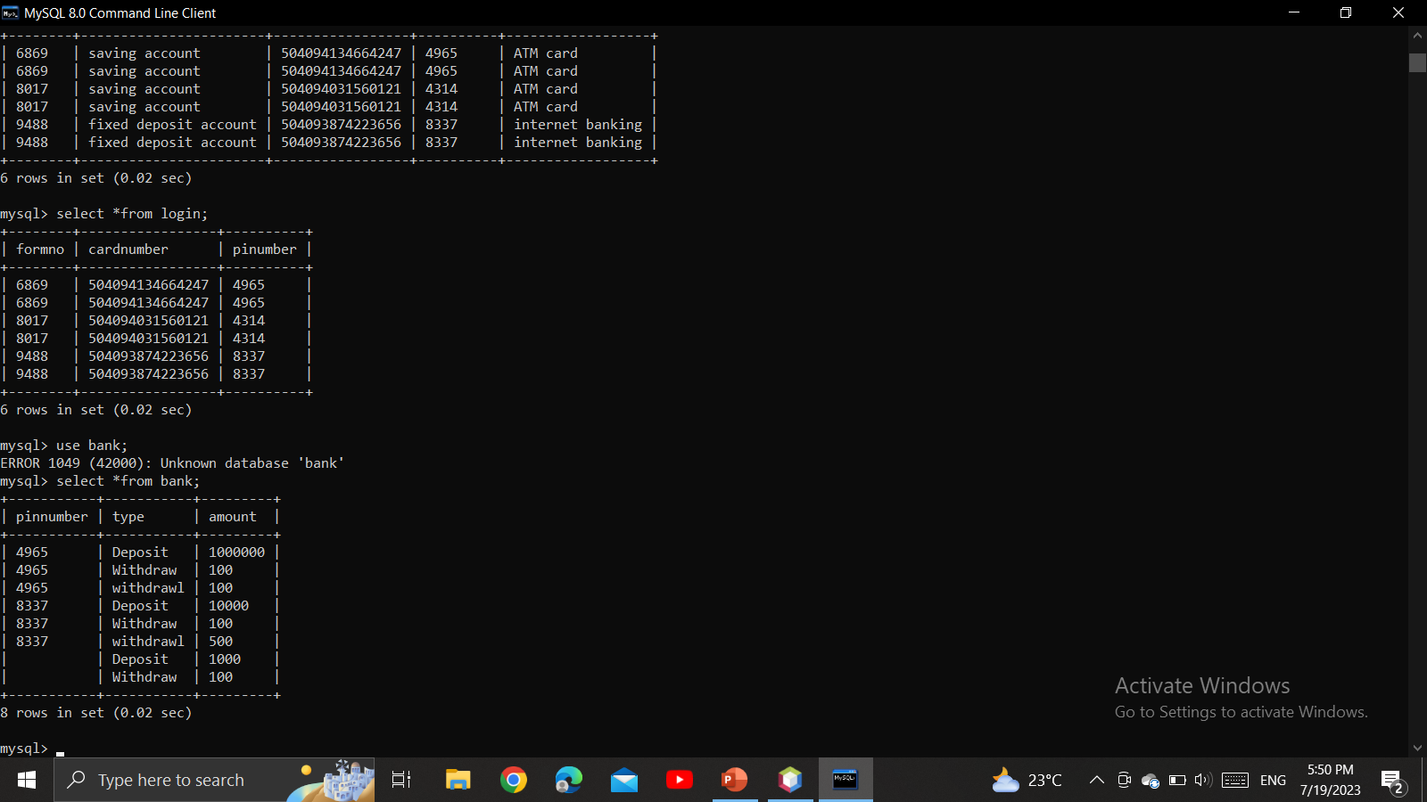
Data in the tables

Slide 23
THANK YOU
..

